Slide 1
INTOSAI KSC
INTOSAI Working Group on Big Data
CONTRIBUTION TO THE IMPLEMENTATION OF THE STRATEGIC OBJECTIVES AND CROSSCUTTING PRIORITIES
CNAO Tang Zhihao
June 13th, 2019 Pampanga, Philippines
SAI CHINA

Slide 2
The strategic objectives and crosscutting priorities
CONTENT
Update on WGBD
Audit Reform in the era of Big Data
Work plan 2020-2022

Slide 3
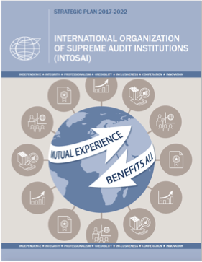
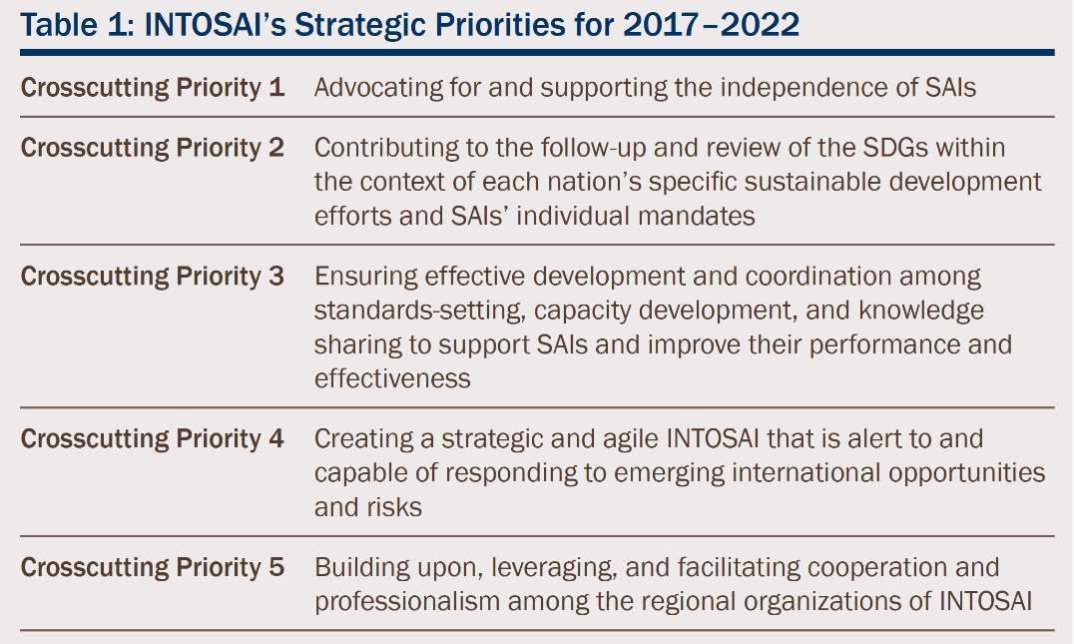
CNAO
The strategic objectives and crosscutting priorities for INTOSAI

Slide 4
CNAO
The strategic objectives for WGBD
Identify the opportunities and challenges that SAIs are facing in a big data world to provide recommendations to SAIs.
Goal
1
Summarize the know-how, experience and good practices concerning big data audit, and develop guidelines and research reports, to share knowledge and help SAIs boost relevant capacities.
Goal
2
Goal
3
Strengthen bilateral, regional and INTOSAI-wide cooperation among SAIs in big data audit.

Slide 5
CNAO
Update on WGBD issues --Members
Chair
China
Vice Chair
United States
Members:
Austria, Bangladesh, Bhutan, Brazil, Denmark, Ecuador, Finland, India, Indonesia, Mexico, the Netherlands, New Zealand, Norway, Pakistan, Russian Federation, Thailand, the United Kingdom, Fiji, the Republic of Korea, Argentina, Kuwait, Portugal, the Philippines, Peru, Senegal and Turkey
Is Being Member
Georgia
Observers
Estonia, AFROSAI-E, ECA

Slide 6
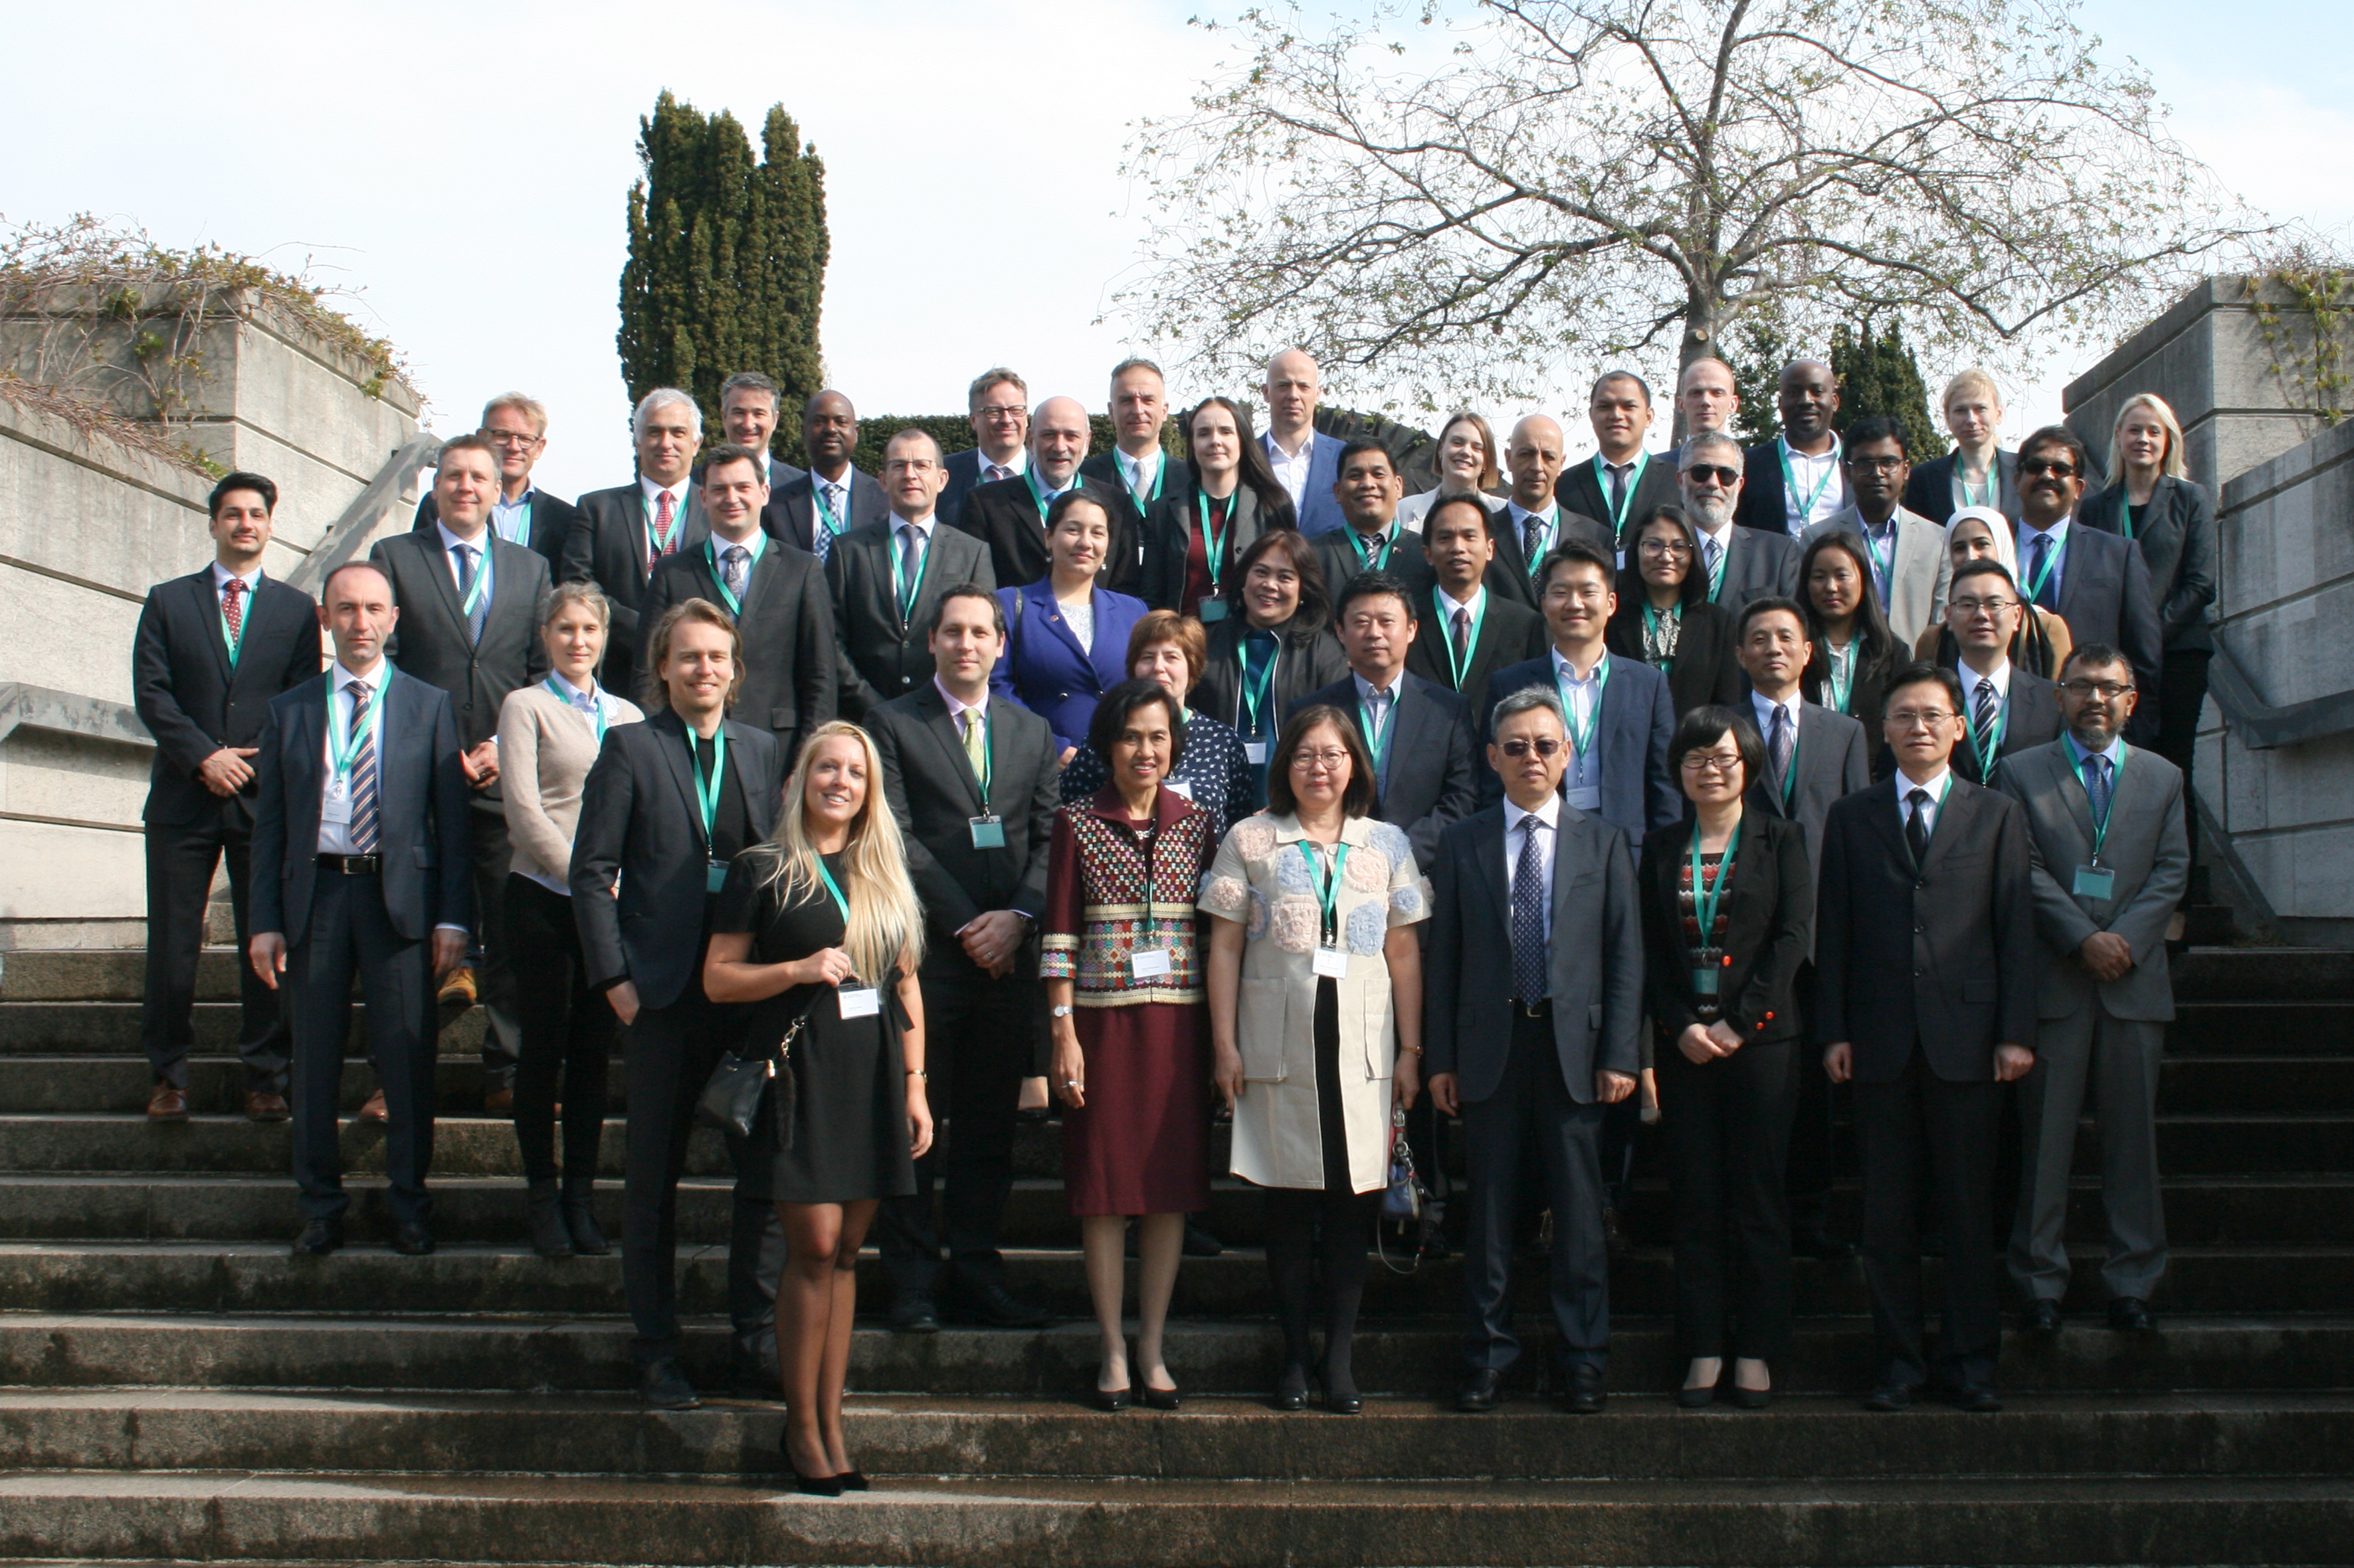
CNAO
Update on WGBD issues --Research
participants
第三次会议图片
with the participation of 51 delegates from 24 member SAIs
Research already carried out
The Indonesia SAI has made an interim report for it continues working group’s “Auditing Technologies Innovation Research Project”
Research already carried out
The participants enthusiastically discussed the “Guidelines On Big Data Audit Research Program” prepared by the secretariat of the working group and unanimously adopted to compile the “Guidelines On Big Data Auditing”.
April 25 to 26, 2019 in Copenhagen, Denmark

Slide 7
CNAO
Audit Reform in the era of Big Data
Field
the field of big data applications is more extensive.
performance audit, financial audit,
and compliance audit.etc.
the application of new technologies is more diverse
Technologies
such as blockchain, machine learning and natural language understanding.etc
Platform
the construction of platform tools is more pragmatic.
such as Estonian X-Road platform, CNAO the third phase of the gold audit project.etc.
Mechanism
the working mechanism of big data audit is taking shape.
cooperates with academic circles and professional think tanks; audit technical training

Slide 8
CNAO
Audit Reform in the era of Big Data
1
?
What is the purpose of implementing big data audit?
2
What is the unique role of big data audit?
3
How can we realize the value of big data audit?

Slide 9
CNAO
Work plan 2020-2022
Working group meetings will be held annually，which will determine the WGBD work plan, research projects and other related matters.
A seminar on innovation and application of big data audit analysis techniques is to be hosted in 2020.
annual meeting
innovation and application
A seminar on working mechanisms of big data audit is to be convened in 2022.
A seminar on audit quality control in a big data environment is to be held in 2021.
quality control
working mechanisms

Slide 10
thank you！
June 13, 2019
Email : intosai-wgbd@audit.gov.cn

